Slide 1
REAL ESTATE
MARKETING PLAN
Recommendation for San Diego RE Market Investors

Slide 2

Business Opportunity
Due to work from home trend, people are moving from Bay area to South California
Investors invest in Real Estate Market due to inflation risk
San Diego house price increases 25% in a year and become one of hottest nationwide real estate market.

Slide 3
PROBLEM
SOLUTION
What area and what type of residential properties to invest? Which has good cash flow or value growth potentials?
Find properties with good rent to value ratios and those with good value growth.

Slide 4
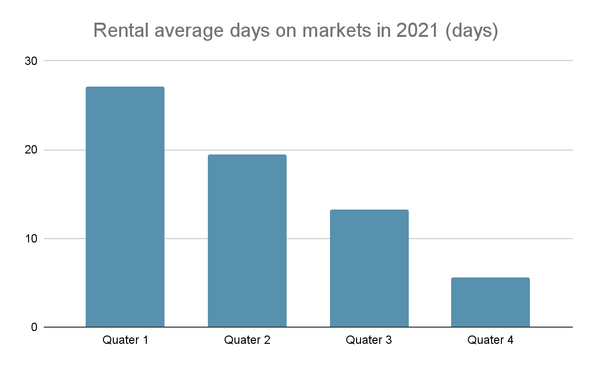
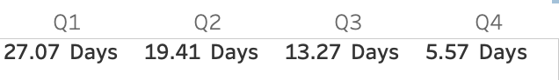
Market summary - RENTAL DAYS ON MARKETS (DOMLS)
Inventory
Shortage
Tens of offers for one property are common

Slide 5
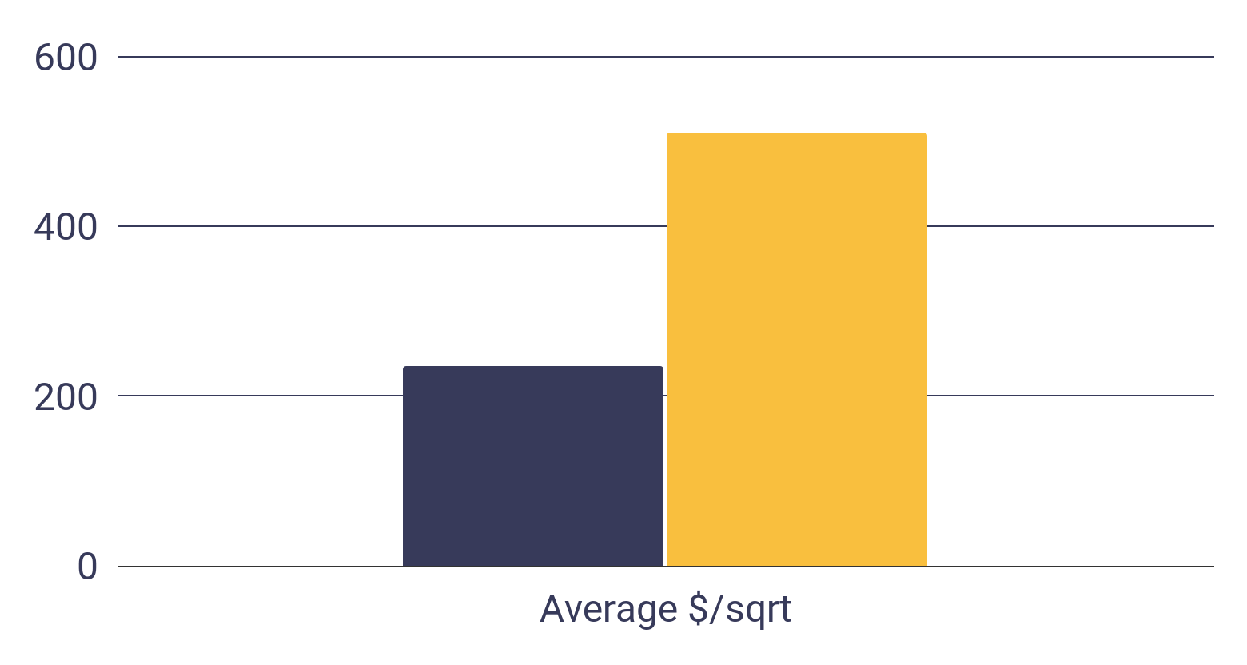
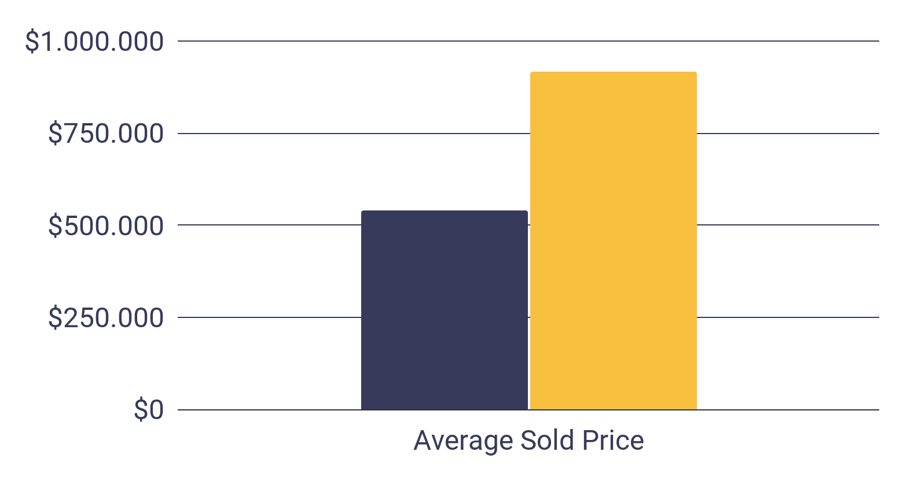
Market summary - VALUE GROWTH
2012
2021

Slide 6
Methodology
Collect Data
EDA
Calculate rent_to_value ratios and value growth percentage for different house (based on combination of several features)
Future work:
Collect complete rental data
Future work:
Advanced algorithm
Purchasing and rental transaction records can
be found in the San Diego Multiple Listing System(MLS).

Slide 7
Assumption & Risk
Assumption | Risk
To calculate the rent to value ratio, we need to estimate the value of rental property through analyzing/modeling purchasing transaction data. | The accuracies of estimation of rental property value depend on the accuracies of regression and machining learning models.
In our initial model,due to limited rental data, we assume location, house type and property size are three biggest elements for deciding property value. In the future work, we should use more features. | Individual outliers will have big impact on the average rent_to_value ratio for a specific property combination, this should be resolved by complete rental data provided and more complicated features in the future.

Slide 8
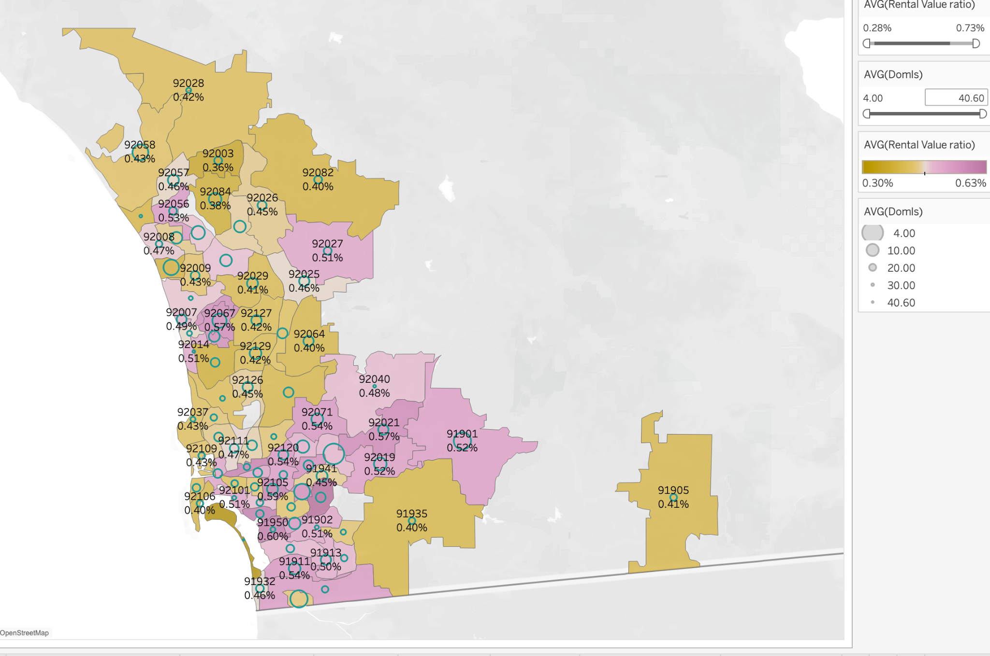
EDA Insight-
Rent_to_value ratio and Days on market by zip code
(link)

Slide 9
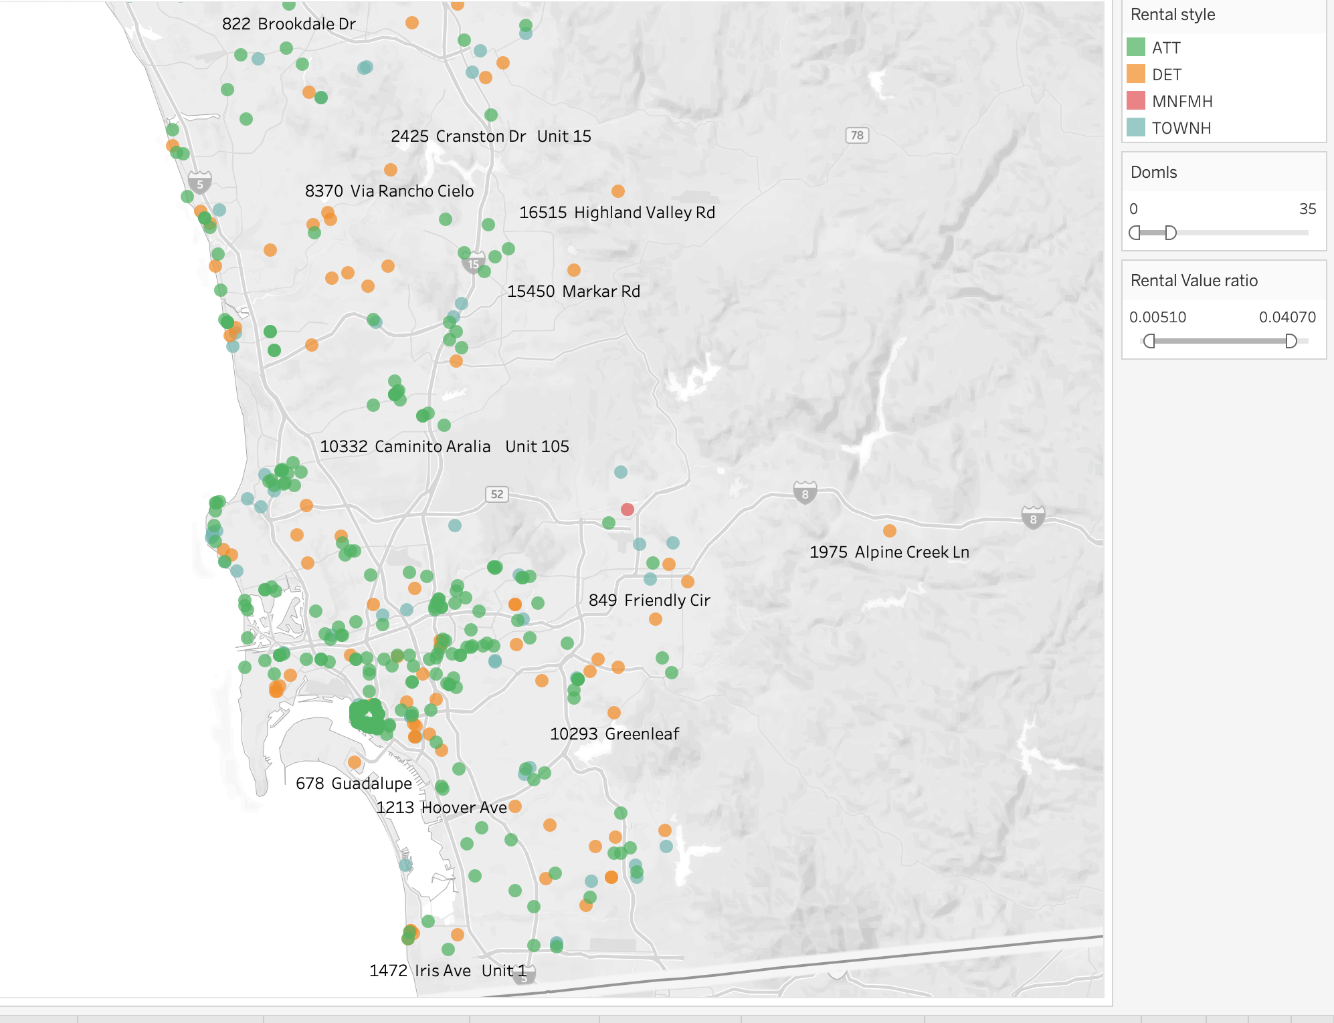
EDA Insight-
Recommend by individual house
(link)

Slide 10
EDA Insight - Recommend by Weighted Index for rentals (top 10)
Zip | Rental_style | sqrt_range | AVERAGE of Rented Price | AVERAGE of Rental_Value_ratio | AVERAGE of DOMLS | Weighted recommend index
91977 | ATT | 500 - 999 | $1,889 | 0.79% | 15.8 | 5.68
92108 | ATT | 500 - 999 | $2,740 | 0.73% | 18 | 4.64
92014 | ATT | 500 - 999 | $3,994 | 0.69% | 22.67 | 3.66
92109 | ATT | 0 - 499 | $1,710 | 0.61% | 16 | 2.71
92115 | ATT | 500 - 999 | $1,845 | 0.60% | 9.29 | 2.66
92120 | ATT | 500 - 999 | $1,878 | 0.59% | 10.8 | 2.44
92107 | ATT | 0 - 499 | $1,575 | 0.59% | 18.2 | 2.21
92024 | ATT | 500 - 999 | $3,029 | 0.58% | 21.2 | 1.96
92105 | ATT | 500 - 999 | $1,556 | 0.56% | 16.22 | 1.85
91932 | DET | 1500 - 1999 | $4,282 | 0.56% | 15.17 | 1.75
Standardize Rental_to_Value_ratio and DOMLS (days on market), calculate weighted index ( 3:-1) and each combination should have at least 5 rental data to decrease the impact of individual nosies.
Weighted index

Slide 11
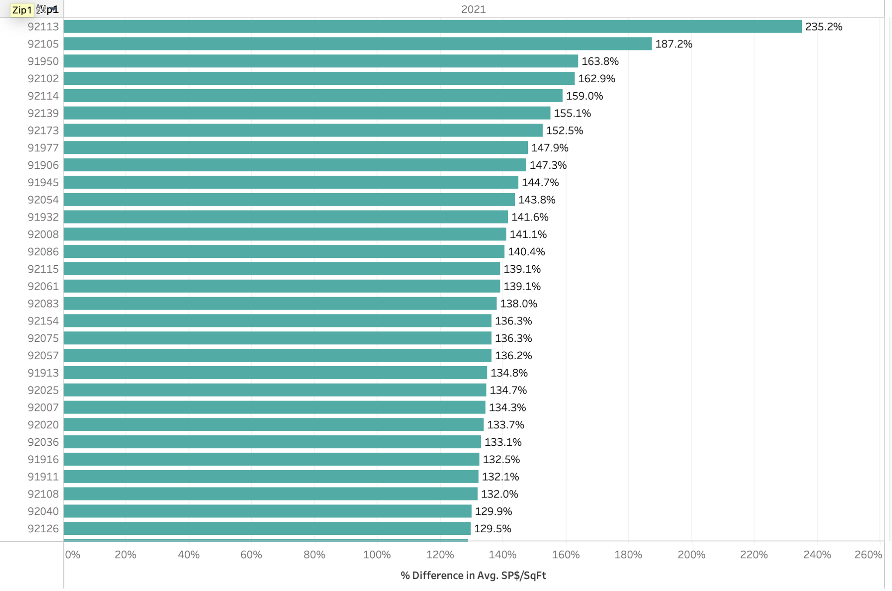
EDA Insight-
Value growth by zip code from 2012 - 2021
(link)

Slide 12
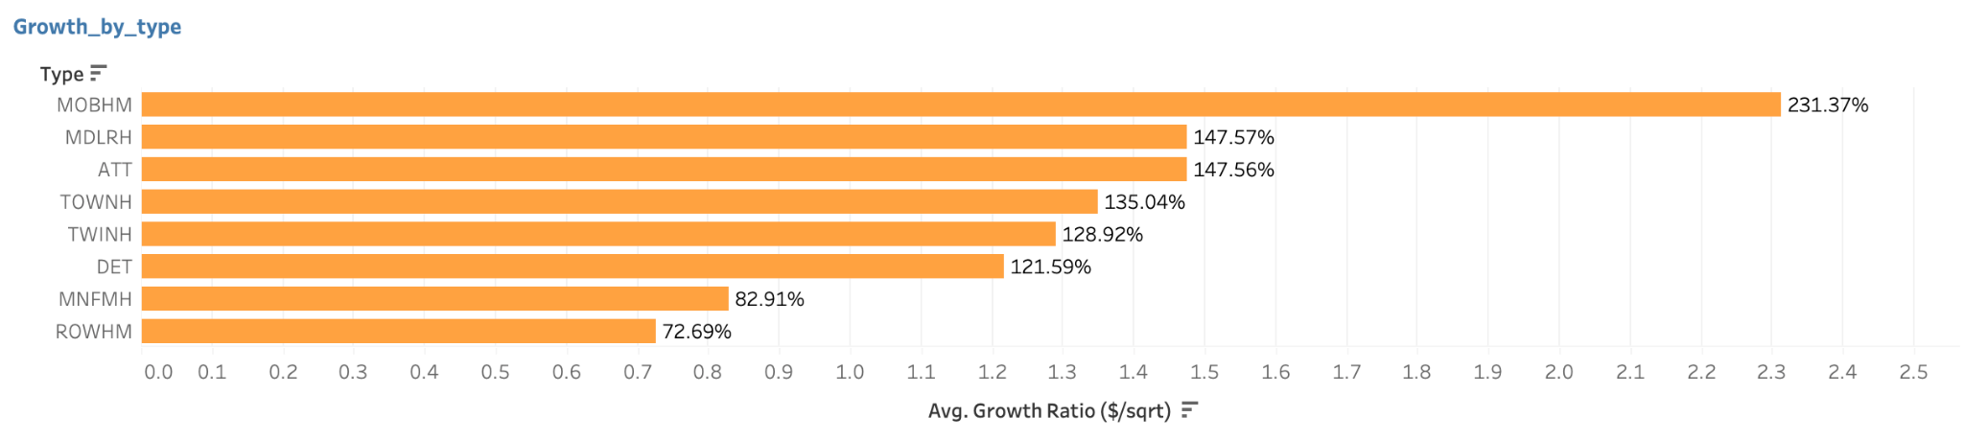
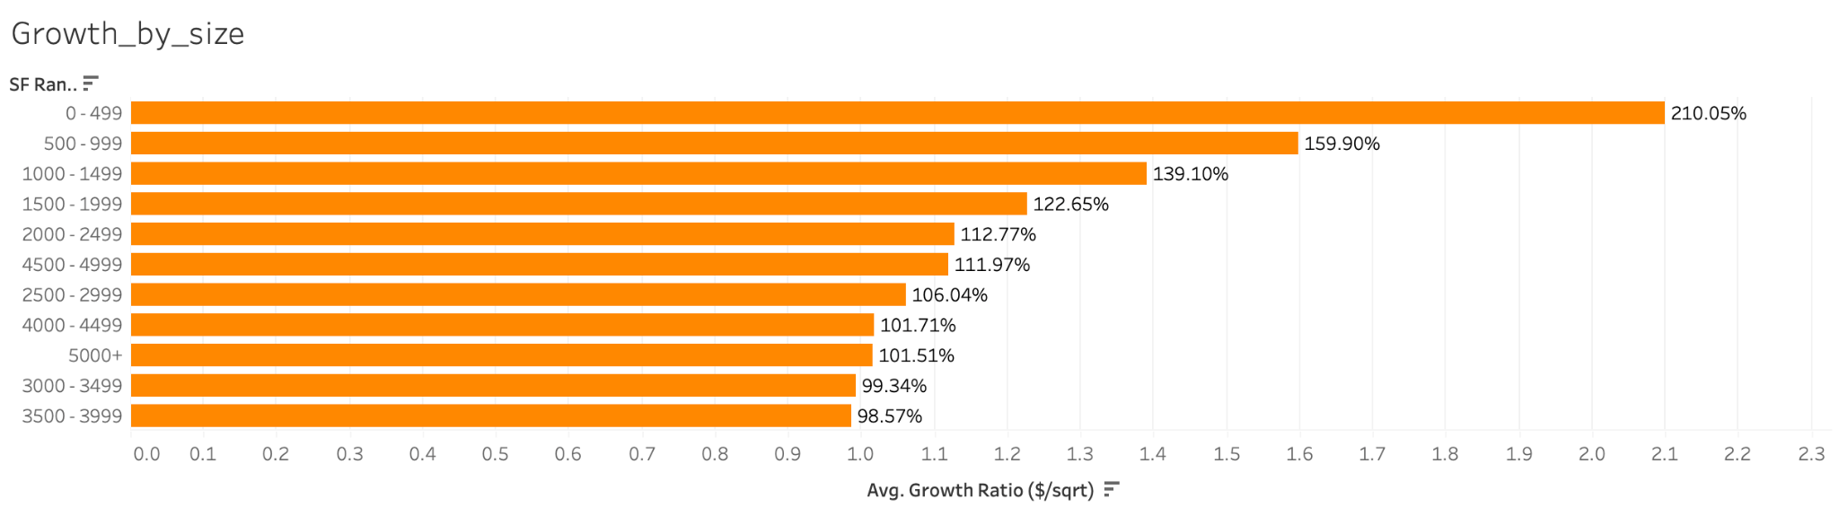
EDA Insight- Value growth by house type and size from 2012 - 2021

Slide 13
EDA Insight - Value growth by zip code & type & SF_range (top 10)
Zip code | Type | SF_Range | Average_soldprice_2021 | Average_soldprice_2012 | Growth Ratio (sold price) | Average_$/sqrt_2021 | Average_$/sqrt_2012 | Growth Ratio ($/sqrt)
92007 | ATT | 1000 - 1499 | $1,302,500 | $364,019 | 257.81% | $1,104.19 | $288 | 283.08%
92102 | ATT | 0 - 499 | $243,716 | $87,500 | 178.53% | $683.62 | $181 | 278.14%
92040 | ATT | 500 - 999 | $315,901 | $85,750 | 268.40% | $384.34 | $106 | 262.44%
92113 | DET | 500 - 999 | $504,944 | $149,145 | 238.56% | $658.67 | $184 | 257.38%
91902 | ATT | 500 - 999 | $318,500 | $87,867 | 262.48% | $498.96 | $141 | 253.28%
92105 | ATT | 1000 - 1499 | $478,125 | $130,080 | 267.56% | $386.09 | $110 | 250.91%
92105 | ATT | 500 - 999 | $296,075 | $86,658 | 241.66% | $405.83 | $117 | 246.44%
91977 | TOWNH | 1000 - 1499 | $448,833 | $132,795 | 237.99% | $392.34 | $113 | 246.35%
92025 | ATT | 1500 - 1999 | $636,833 | $181,750 | 250.39% | $381.99 | $111 | 242.70%
92083 | ATT | 500 - 999 | $343,658 | $102,625 | 234.87% | $417.53 | $123 | 239.24%
Each combination should have at least 10 selling data to decrease the impact of individual nosies.

Slide 14
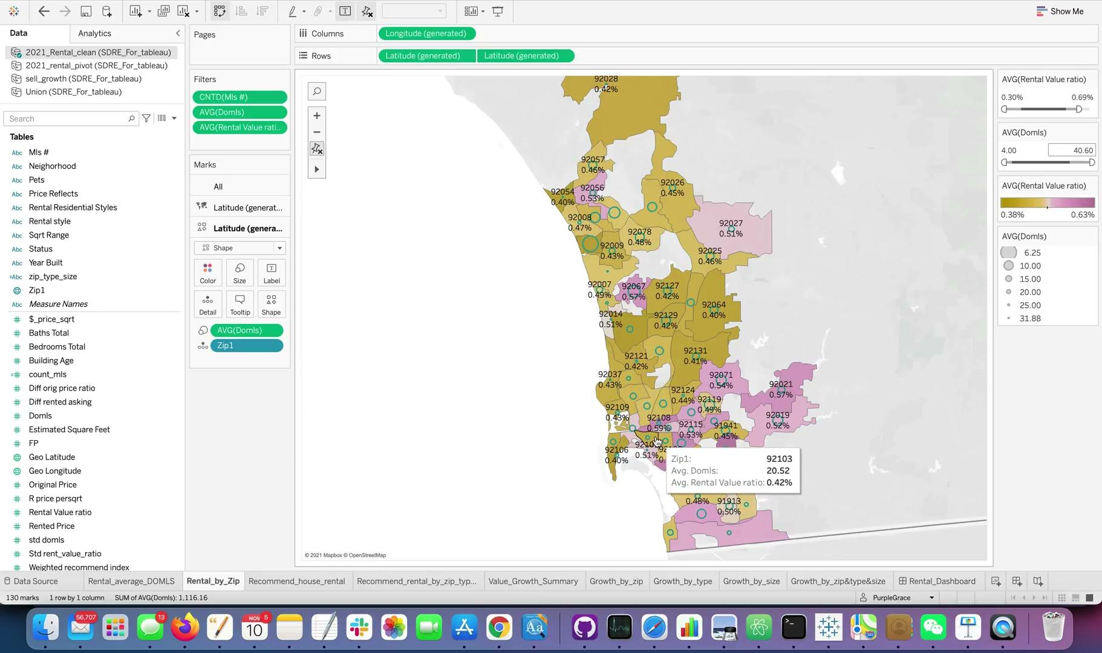
Tableau video clip (link)

Slide 15
Linear regression model to predict house value, so that investors can find properties with better rent_to_value ratio.
Time series model to forecast future house value, so that investors to find properties with good value growth potentials.
Clustering Algorithms to help find good substitutes when desired property type is not available on the market.
Future work

Slide 16
Thanks
& Questions

